Slide 1
SURF 2022 Group B Progress Report 3

Slide 2
Contents
UWMGI summary
HubMap Competition Review
Future Plans for HubMap Competition
Discussions

Slide 3
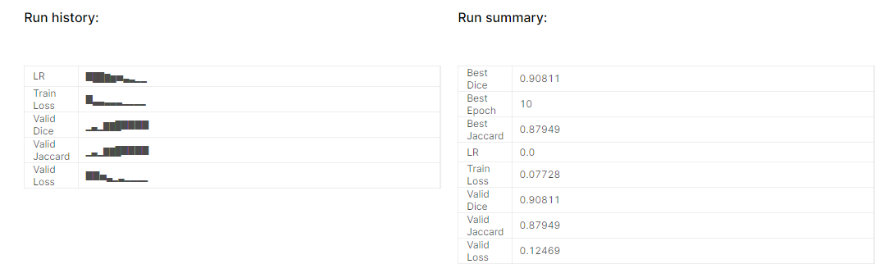
Additional Methods
Compared from the last report, we have tested 2.5D datasets with another model: MobileNet encoded Unet++
The running outcome has resulted as the following:

Slide 4
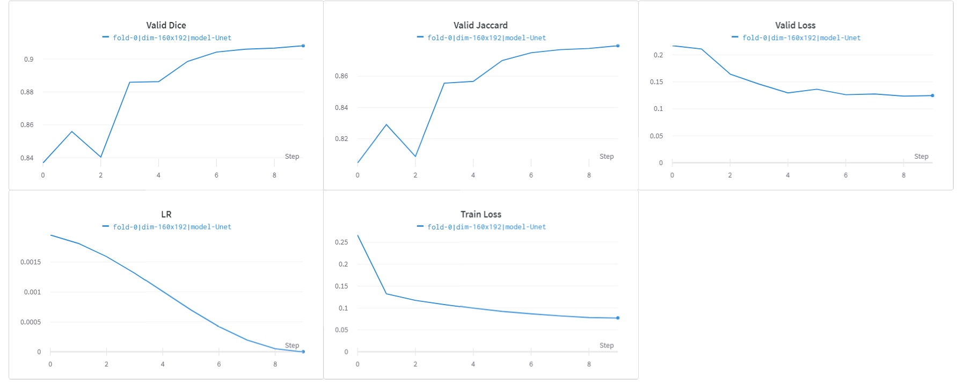
Validity and Loss

Slide 5
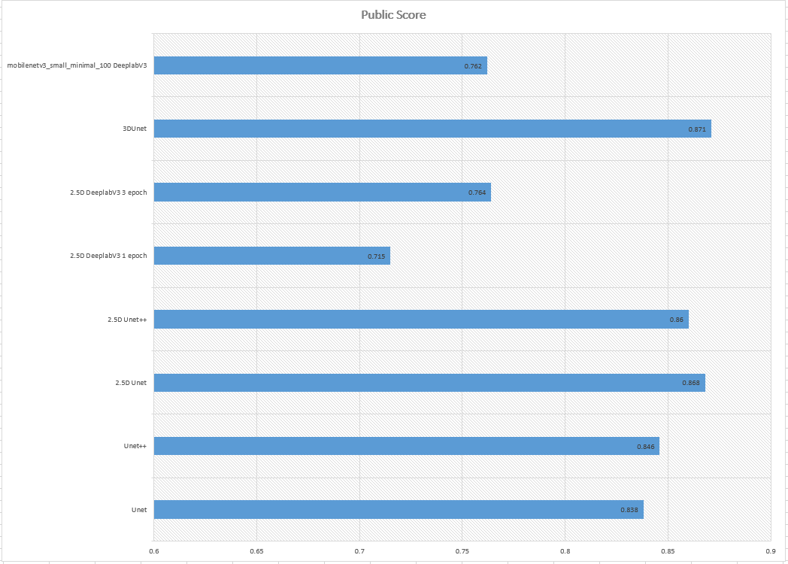
Results on UWMGI competition

Slide 6
Final Score

Slide 7
Difficulties
Limited GPU Quota on Kaggle and long time to run a submission for larger models.
Complex dataset in which contains more dimensions than just 2D samples.
Environment requirement is quite hard to meet since the versions may always be incompatible with each other, e.g. incompatibilities between torch and torchvision under specific version.

Slide 8
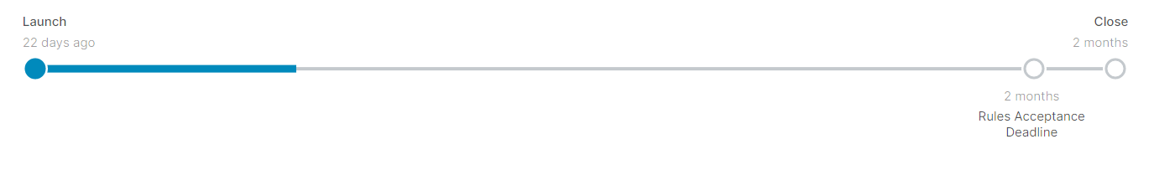
HubMap Competition Overview
The next competition we are aiming for is HuBMAP + HPA – Hacking the Human Body
This competition is working to create a Human Reference Atlas at the cellular level.
Thus, we need to identify and segment functional tissue units (FTUs) across five human organs with a dataset of tissue section images
Reference: https://www.nature.com/articles/s41556-021-00788-6

Slide 9
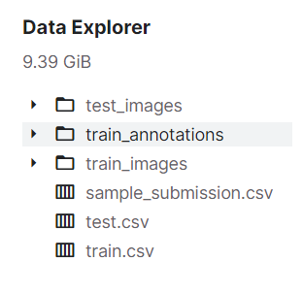
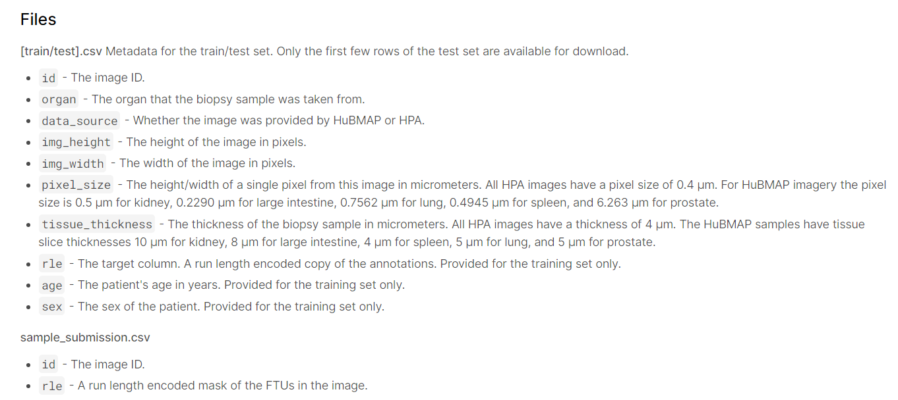
HuBMAP Dataset Analysis
[train/test]_images/
All HPA images are 3000 x 3000 pixels with a tissue area within the image around 2500 x 2500 pixels. The HuBMAP images range in size from 4500x4500 down to 160x160 pixels.
All images used have at least one FTU.

Slide 10
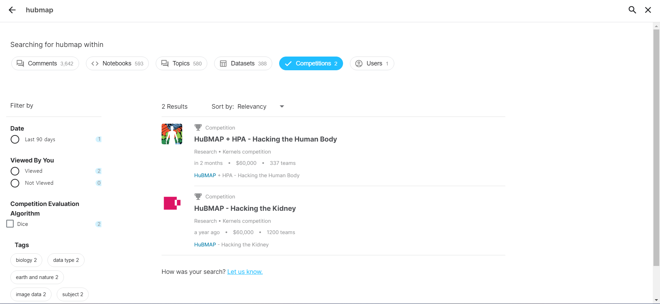
Future Plans for HuBMAP
We will first start with U-net family models.
Then do some fine-tune with regards to some similar previous HuBMAP Competitions.

Slide 11
Discussions

